Slide 1
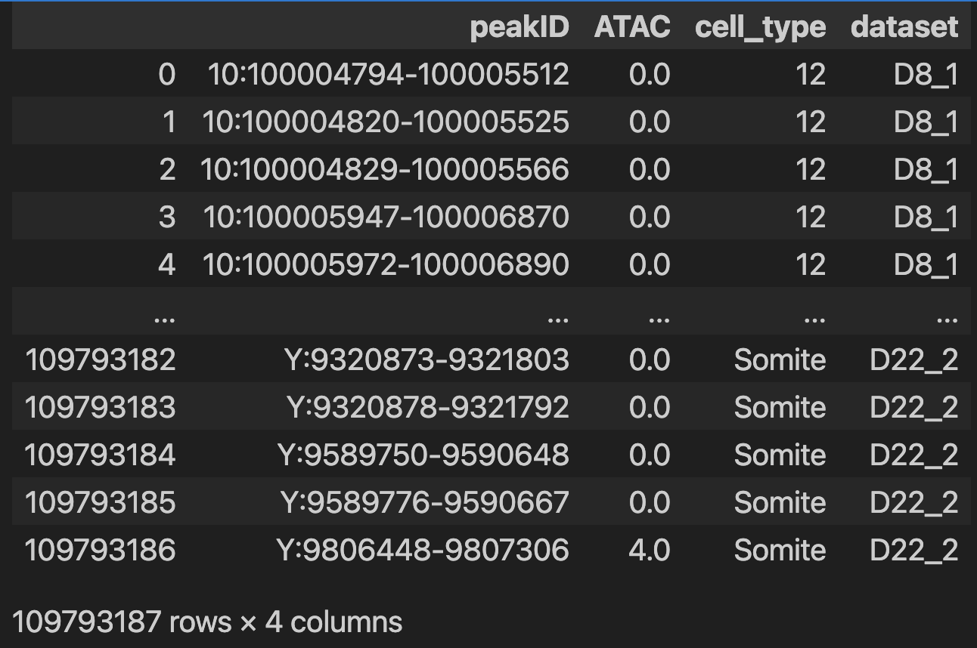
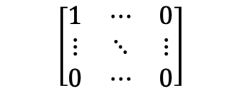

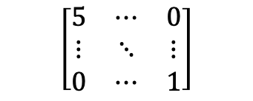
10x peak count x cell matrix
Peaks
Pseudo bulk by time + cell type
Peaks
Cells from all time points
$$\left[\begin{matrix}1 & ⋯ & 0 \\ ⋮ & ⋱ & ⋮ \\ 0 & ⋯ & 0\end{matrix}\right]$$
$$\left[\begin{matrix}5 & ⋯ & 0 \\ ⋮ & ⋱ & ⋮ \\ 0 & ⋯ & 1\end{matrix}\right]$$
Normalization to account for cell number ?
For each peak
Get sequence on reference genome
One hot encode it
Pseudo bulk ATAC read count
-> discrete
A G T
$$\begin{matrix}1 & 0 & 1 \\ 0 & 0 & 0 \\ \begin{aligned}0 \\ 0\end{aligned} & \begin{aligned}1 \\ 0\end{aligned} & \begin{aligned}0 \\ 0\end{aligned}\end{matrix}$$
Chr 10: 902758- 902820
Which sequence do we use?
Exact peak
Peak with fixed number bp around
Exact length around center peak
What to do with the N in the sequences?
Exclude sex chromosomes?
Aggregate for some time + cell type -> very few cells. Do still keep those pseudo bulk? Probably not enough cells to be good estimate of tracks
Aggregate for some time + cell type -> very few cells. Do still keep those pseudo bulk? Probably not enough cells to be good estimate of tracks

Slide 2
Get the countinous track with base resolution

